Slide 1



AI-POWERED CYBER
INTRUSION DETECTION SYSTEM
(CIDS)
Based on Supervised Machine Learning
Submitted To: Dr. Geethika Sethi
Submitted By:
Sarvagya Singh (12305812)
Pritish Majumdar (12309642)
Daksh Kaushal (12321086)
B.Tech CSE (AI & ML)

Slide 2
PRESENTATION OUTLINE
Background
Web App & Deployment
Problem Statement
Results & Analysis
Objectives
Innovation
Scope & Importance
Caveats & Limitations
Methodology
Conclusion
Model Architecture
References
Training & Evaluation
Acknowledgments

Slide 3

BACKGROUND
The project focuses on designing and deploying an AI-based Cyber Intrusion Detection System (CIDS) capable of classifying network traffic into benign and malicious categories using 27 supervised ML models.
Traditional signature-based IDS fail against modern threats:
Zero-day attacks
Polymorphic malware
High-volume DDoS
Stealthy infiltration attacks

Slide 4


PROBLEM STATEMENT
THE CHALLENGE
Modern networks generate massive volumes of traffic where malicious patterns are difficult to detect manually.
TRADITIONAL IDS LIMITATIONS
High false-positive rates
OBJECTIVE
Build a robust ML-powered IDS capable of accurate multiclass attack identification using real-world traffic data (TII-SSRC-23).
Inability to detect new (zero-day) threats
Lack of adaptability to changing patterns
Performance bottlenecks at scale

Slide 5





OBJECTIVES
PRIMARY OBJECTIVE
Develop an end-to-end, supervised learning–based IDS deployed as a real-time web application.
DATA PIPELINE
MODEL TRAINING
DEPLOYMENT
Data cleaning, encoding, scaling & extensive feature engineering.
Training 27 ML models across 9 algorithm families.
Build interactive Streamlit app for real-time inference.

Slide 6


SCOPE OF WORK
CURRENT CAPABILITIES
FUTURE SCOPE
Handles multiclass classification (DoS, DDoS, Brute Force, Port Scan, Botnet)
GNN-based traffic graph modeling
Real-time packet sniffing integration
Works with preprocessed CSV inputs
Zero-day detection using unsupervised learning
Comparative evaluation of 27 models
Automated response mechanisms
Fully accessible through Cloud-based Streamlit app

Slide 7





IMPORTANCE & APPLICABILITY
WHY THIS MATTERS
Traditional IDS fail against sophisticated attacks.
SOC Automation
Network Security
Increasing cyberthreats across defense, finance, healthcare.
ML-based systems adapt to new traffic patterns.
Supports forensics & threat intelligence.
Cyber Forensics
Research Platform

Slide 8
METHODOLOGY PIPELINE
1. ACQUISITION
2. PREPROCESSING
3.
MODELING
4. EVALUATION
5. DEPLOYMENT
TII-SSRC-23 Dataset
27 Models, 9 Families
F1, ROC-AUC, Matrices
Streamlit Cloud
Cleaning, Scaling, SMOTE

Slide 9








DATASET: TII-SSRC-23
KEY FEATURES
Duration statistics & Traffic volume metrics
Protocol & port info
Behavioral indicators (Byte ratios, flag counts)
27.5 GB
Challenge: High class imbalance
Total Data
ATTACK CATEGORIES
Benign
DDoS
DoS
Brute Force

Slide 10

DATA PREPROCESSING
Null Handling: Removal of duplicates & nulls.
Cleaning: Dropped timestamps & Flow IDs.
Encoding: Label Encoding for protocols/flags.
Scaling: StandardScaler (Z-score normalization).
Balancing: SMOTE & Class Weights applied.

Slide 11





FEATURE ENGINEERING
Engineered features significantly improved discriminative power for detecting stealthy attacks.
FLOW SYMMETRY SCORE
BYTE RATIO
Calculates the balance between incoming and outgoing bytes/packets. Helps detect exfiltration (one-way high volume).
Ratio of payload bytes to header bytes. Effective for spotting tunneling or encapsulated attacks.
TCP FLAG AGGREGATES
PACKET DENSITY
Sum counts of SYN, FIN, RST flags. Crucial for detecting scanning (SYN flood) and connection drops.
Packets per second within a flow window. High density indicates DDoS or flooding attempts.

Slide 12









MODEL ARCHITECTURE (27 MODELS)
We implemented 9 model families, each with 3 hyperparameter variants.
Random Forest
Decision Tree
XGBoost
LightGBM
AdaBoost
CatBoost
Logistic Regression
Naive Bayes
KNN

Slide 13



TRAINING & EVALUATION SETUP
DATA SPLIT
EVALUATION METRICS
Accuracy
80-20 Stratified Train-Test Split to maintain class distribution.
Precision (Weighted)
Recall (Sensitivity)
VALIDATION
F1-Score (Harmonic Mean)
ROC-AUC Score
K-Fold Cross-validation ensuring model stability.
Confusion Matrices

Slide 14
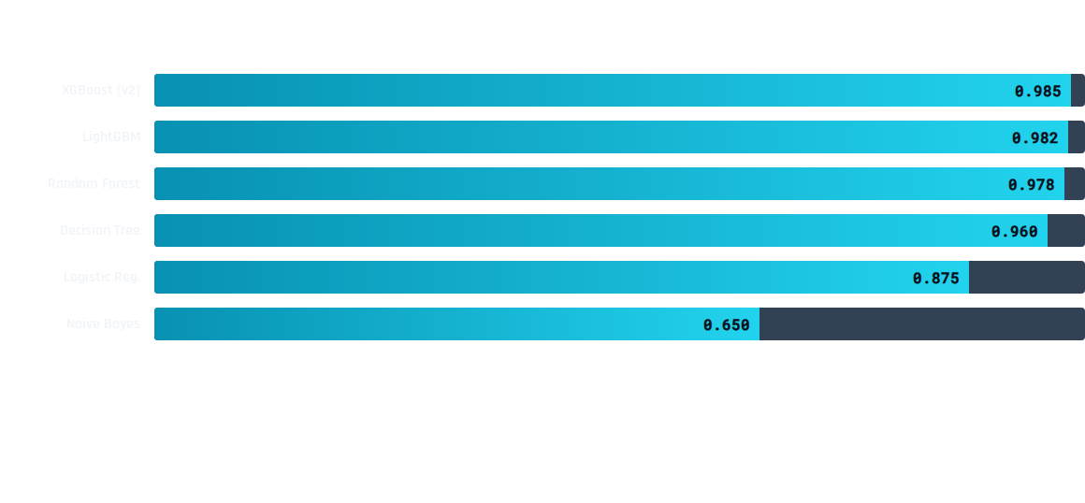


PERFORMANCE COMPARISON (F1-Score)
TOP PERFORMER
FASTEST INFERENCE
MOST ROBUST
XGBoost (xgb2)
Best F1 ~ 0.985
LightGBM (lgbm3)
Low Latency
Random Forest (rf2)
Stable Variance

Slide 15

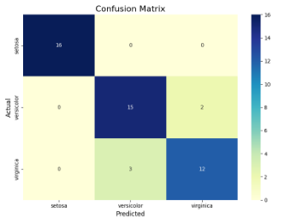
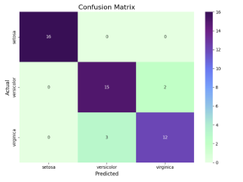
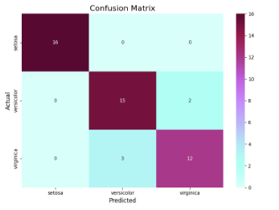
CONFUSION MATRICES
Comparing classification granularity for Top 3 Models
XGBoost
Decision Tree
Random Forest
Insight: Benign detection ~99%. SMOTE significantly improved rare class detection (DDoS/DoS).

Slide 16
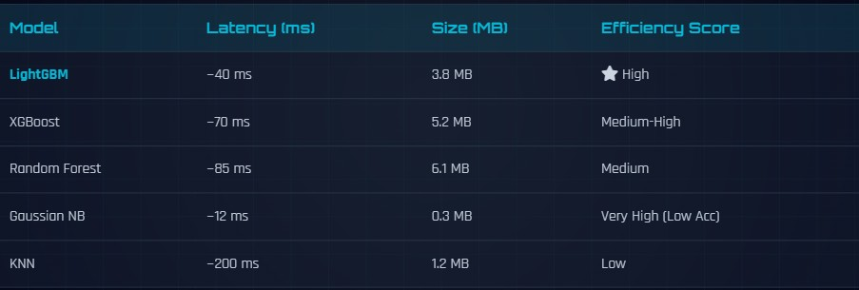
INFERENCE LATENCY & MODEL SIZE

Slide 17
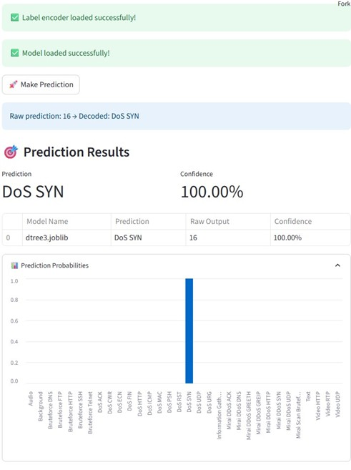
WEB APPLICATION
Built with Streamlit for real-time interaction.
Upload CSV: Auto-preprocessing pipeline.
Model Selection: Choose from 27 trained models.
Visuals: Probability distributions & confidence scores.
Optimization: Uses @st.cache_resource for speed.

Slide 18
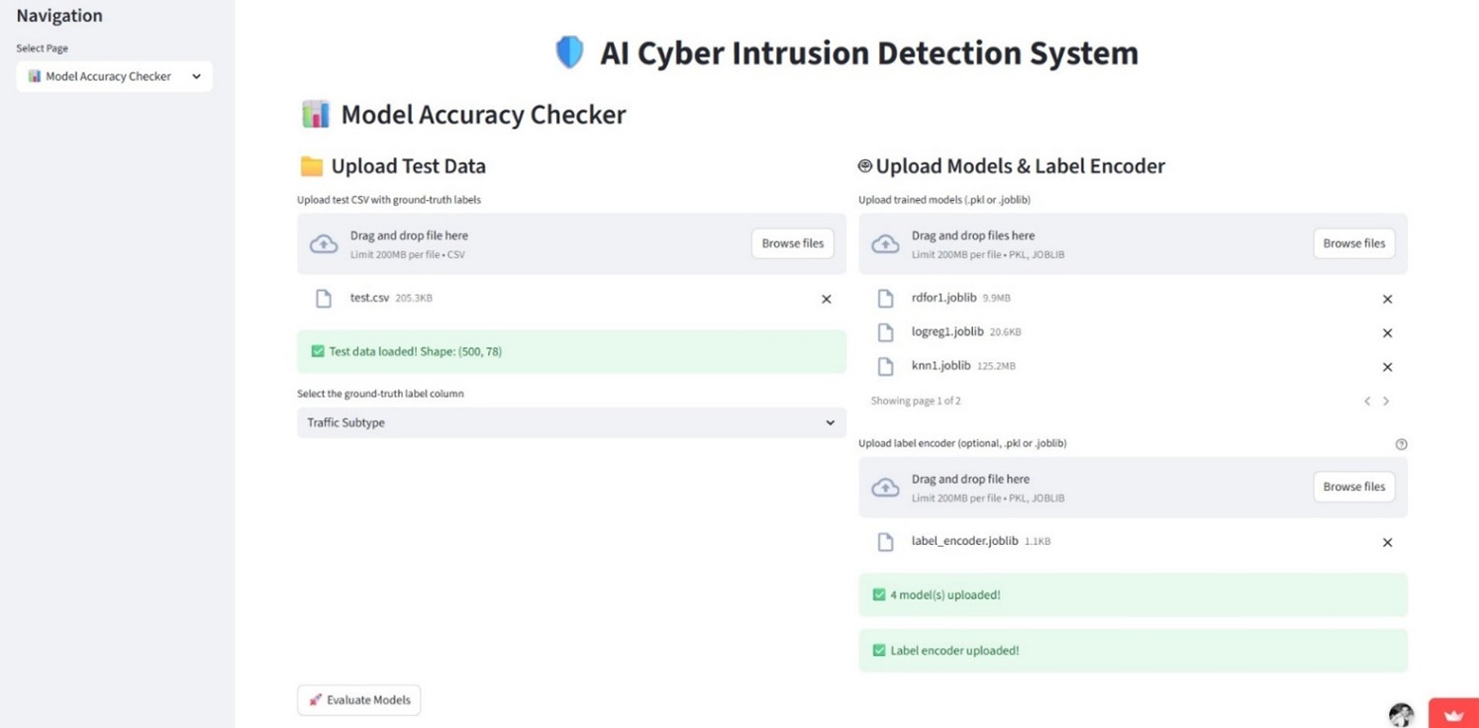

Slide 19







INNOVATION
27-MODEL ENGINE
FEATURE-RICH LAYER
Not a single IDS — a benchmarking suite for comprehensive attack detection.
Advanced metrics: flow symmetry, packet density, byte ratios.
MODULAR ML
CLOUD-NATIVE
Plug-and-play architecture supporting future GNNs and Autoencoders.
Zero-installation, globally accessible predictive system.

Slide 20

CAVEATS & LIMITATIONS
Zero-Day Blindspot: Purely supervised models cannot detect completely new signatures.
Schema Dependency: Requires preprocessed CSV with exact feature schema.
No Packet Sniffing: Currently relies on flow records, not raw packet inspection.
Interpretability: Boosting models lack native SHAP/LIME integration in this version.
Dependent on Training Data Quality

Slide 21

CONCLUSION
Built a complete end-to-end ML-powered IDS using 27 supervised models.
Ensemble models like XGBoost, LightGBM, Random Forest achieved strongest performance.
Deployment as a Streamlit cloud web app enables real-time accessibility.
Modular architecture ensures future extensibility toward anomaly detection.
Demonstrates how AI can significantly elevate cybersecurity readiness.

Slide 22
REFERENCES
TII-SSRC-23 Dataset – IEEE Access (2023)
Scikit-learn Documentation (sklearn.org)
Moustafa & Slay, "UNSW-NB15: a comprehensive data set for network intrusion detection" (MilCIS 2016)
Streamlit Documentation (docs.streamlit.io)
XGBoost & LightGBM Official Repositories
Chawla et al., "SMOTE: Synthetic Minority Over-sampling Technique" (JAIR, 2002)

Slide 23
ACKNOWLEDGMENTS
We gratefully acknowledge the guidance of:
Dr. Geethika Sethi
Mentor and Project Supervisor
Lovely Professional University

